Slide 1
Simple Emergency Department Simulation for patient flow optimisation
A research Internship under Mrs. Diana Olivia,MIT Manipal

Slide 2
About the Project
This project tries to solve a serious problem prevalent in the emergency department of hospitals. Emergency Department (ED) overcrowding gradually becomes a serious problem which reduces quality of emergency care, increased costs of patients, and decreased physician job satisfaction.
The Discrete event simulation(DES) is a computer model that simulates the dynamic behaviour of a real process and be used to visualise and quantitatively analyse the performance of the process.
Two models were constructed, a Single queue-Single server and a Single queue-Multi server.

Slide 3

Software used
Simulink is a MATLAB-based graphical programming environment for modelling, simulating and analysing multi-domain dynamical systems.
Its primary interface is a graphical block diagramming tool and a customisable set of block libraries. It offers tight integration with the rest of the MATLAB environment and can either drive MATLAB or be scripted from it.
Simulink is widely used in automatic control and digital signal processing for multi-domain simulation and model-based design

Slide 4
Execution Phase
The initial period of the project phase was spent in studying the paper on Patient Flow Optimisation in Emergency Departments.Once that was done, the implementation work began. This included working on MATLAB Simulink.
A restaurant simulation was first constructed to understand the working of the model and get in-depth knowledge of the software.
Mimicking this, the Emergency department(ED) simulation was constructed, and the following attributes were calculated:
Waiting time
Service Rate/Average Queue Length
Arrival rate

Slide 6
Models
To get the simulation going, a model was constructed to show random patients entering the checkout area. Entities in SimEvents was used to represent patients and to generate these entities at random time intervals following an exponential distribution.
During generation ,a random duration was specified (also exponentially distributed) that a patient will take to be served at a server by assigning a special attribute to the corresponding entity. Average service time (usually denoted by 1/𝜇) was taken as 2 mins and the average arrival time (usually denoted by 1/𝜆) as 1 min.

Slide 7
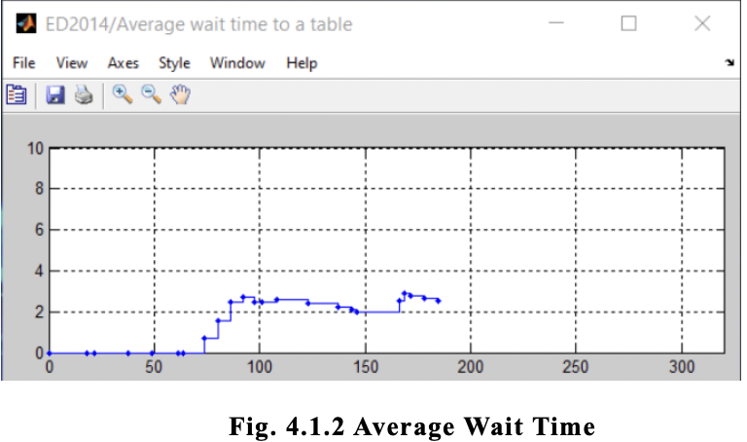
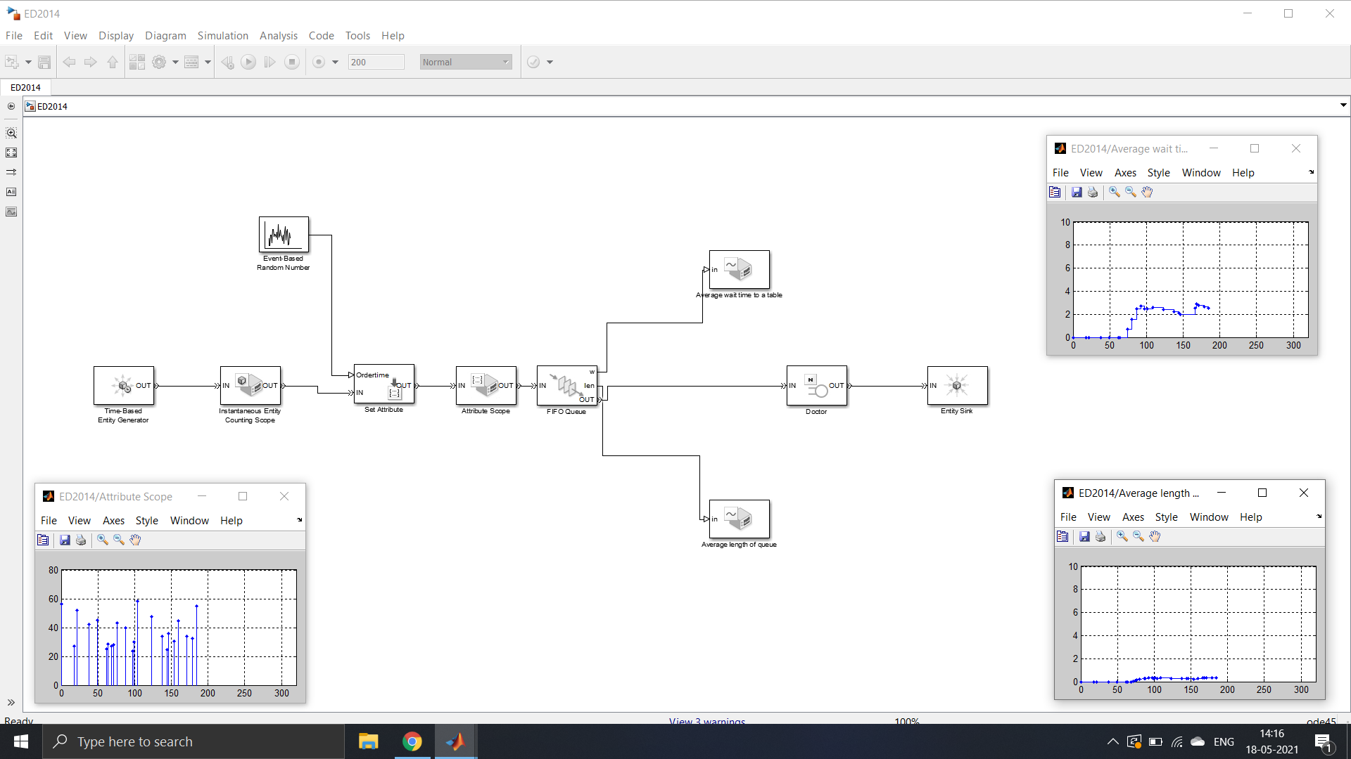
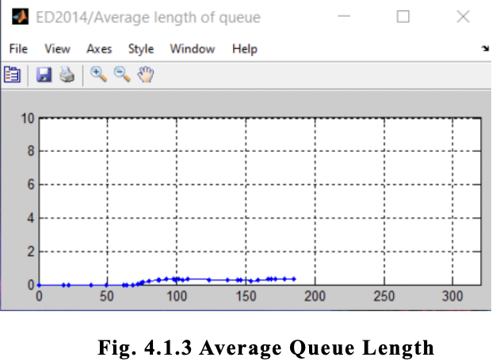
Single Server

Slide 8
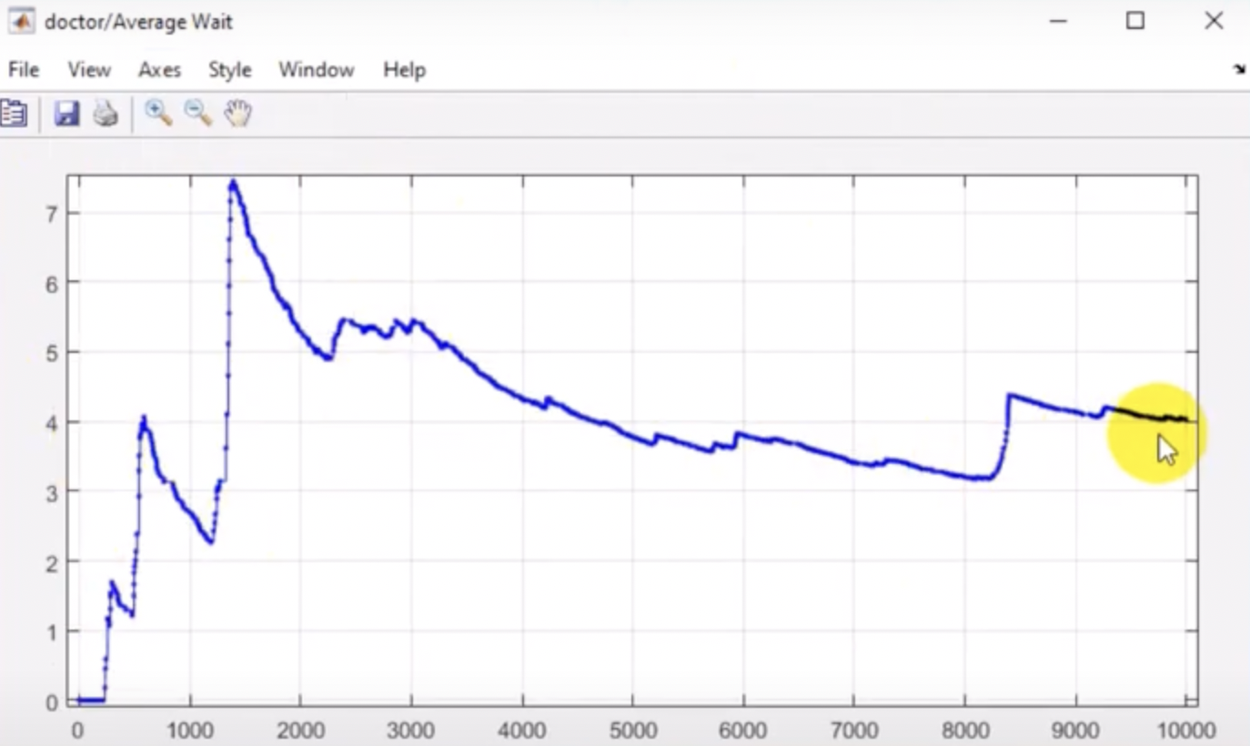
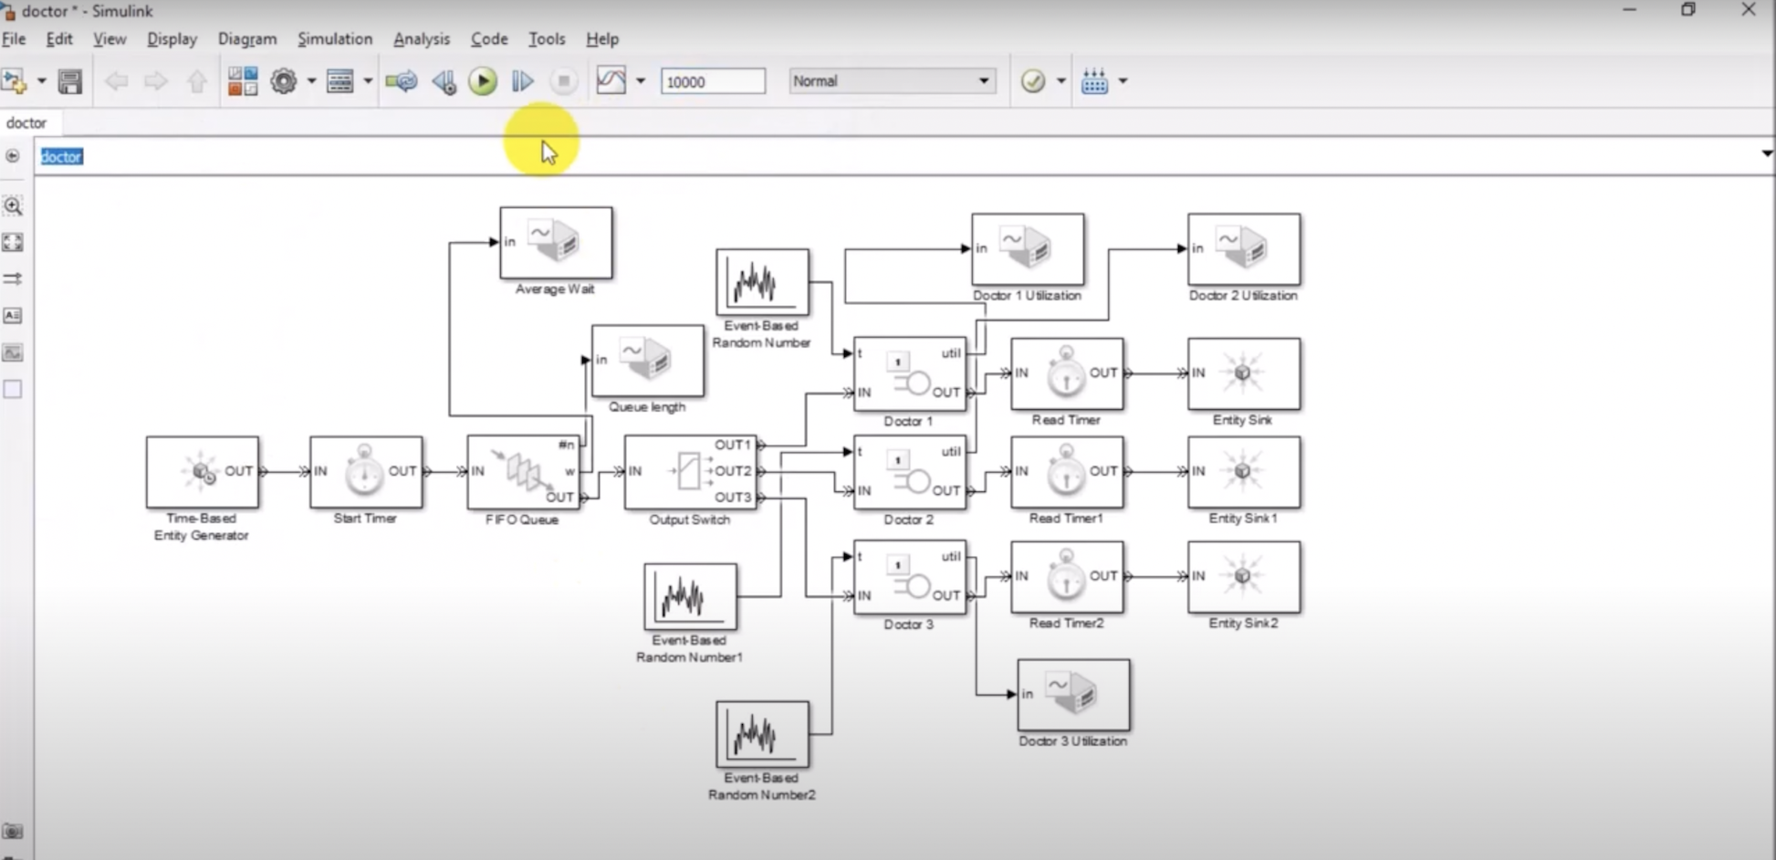
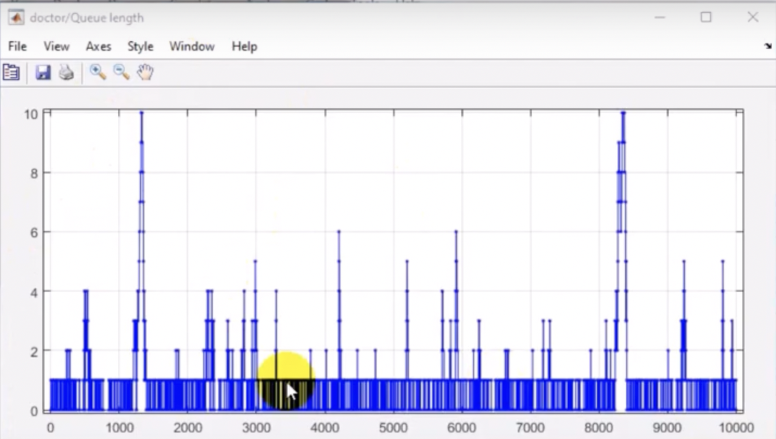
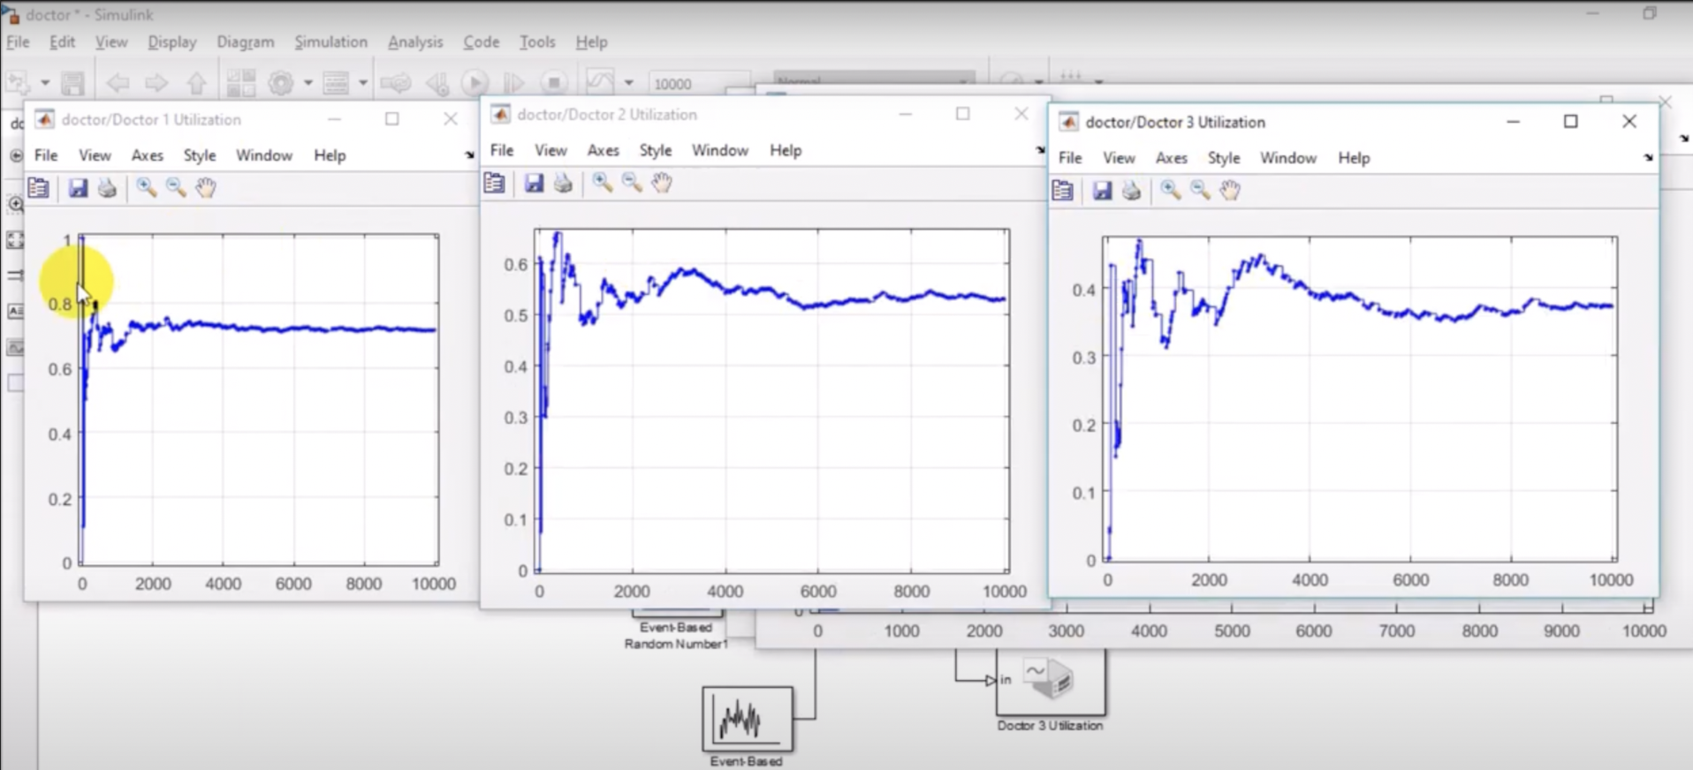
Multi-Server

Slide 9
Observation
On running both the test models, the following observations were made:
A single powerful server can only be upgraded so far. Once you have the most powerful server available, the system cannot grow until multiple server with the same capability are used.
A multi server system, drastically reduces the wait time and the queue length. With multiple servers(be it doctors, nurses e.t.c) with each server equally capable, it improves the efficiency.
A single server that is super powerful may cost ten times as much as two servers that are half as powerful. With two or more servers, one can fail or if is unavailable, the system can still function.

Slide 10
Conclusion
After implementing multiple simulations,(Single server and Multi Servers), the factors, such as Average Queue length, Average Wait time ,that help decide if the Emergency Departments to be effective or not, are calculated.
If the average wait time is low , doctor(server) utilisation is high and the average queue length is low, the Emergency Departments are said to be effective.
To increase the efficiency of the ED’s even more, more servers can be added, given the cost and the serving entities are not fluctuated by a significant amount.

Slide 11
Thank You
-Saarthak Khandelwal

